Slide 1
Automatic Flat Coloring
Shuo Wen

Slide 2
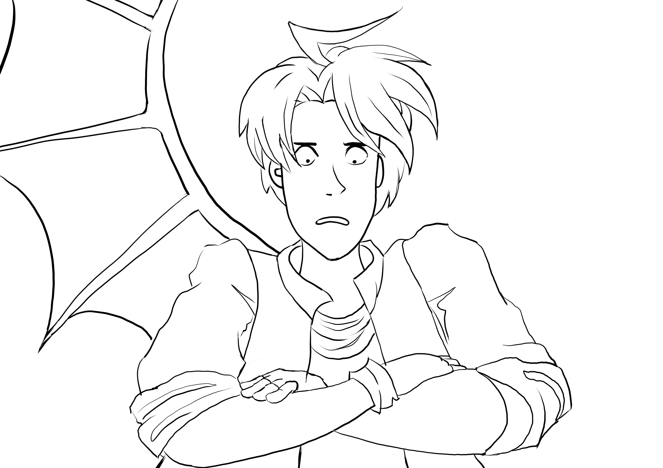


Review - Our Goal
Line-art
Flat coloring
Shadows and other effects added
1. Divide the lineart into regions. (Implemented in GMIC¹)
2. Assign a color for each region.
a. Assign colors for all pixels in the region
b. Take the median of RGB value of the pixels

Slide 3
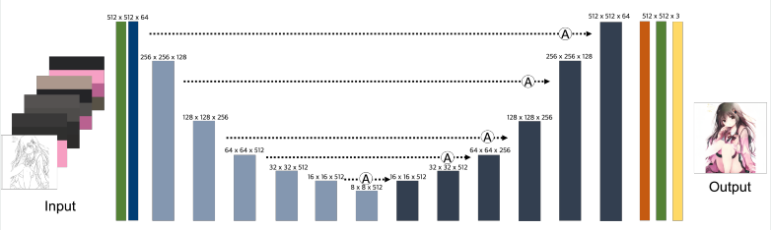
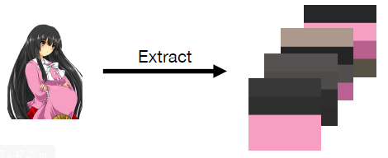
Review - Basic Model: Attentioned Deep Paint
Reference Image
Generator: Attention U-net
1：https://github.com/ktaebum/AttentionedDeepPaint/blob/master/poster.pdf

Slide 4
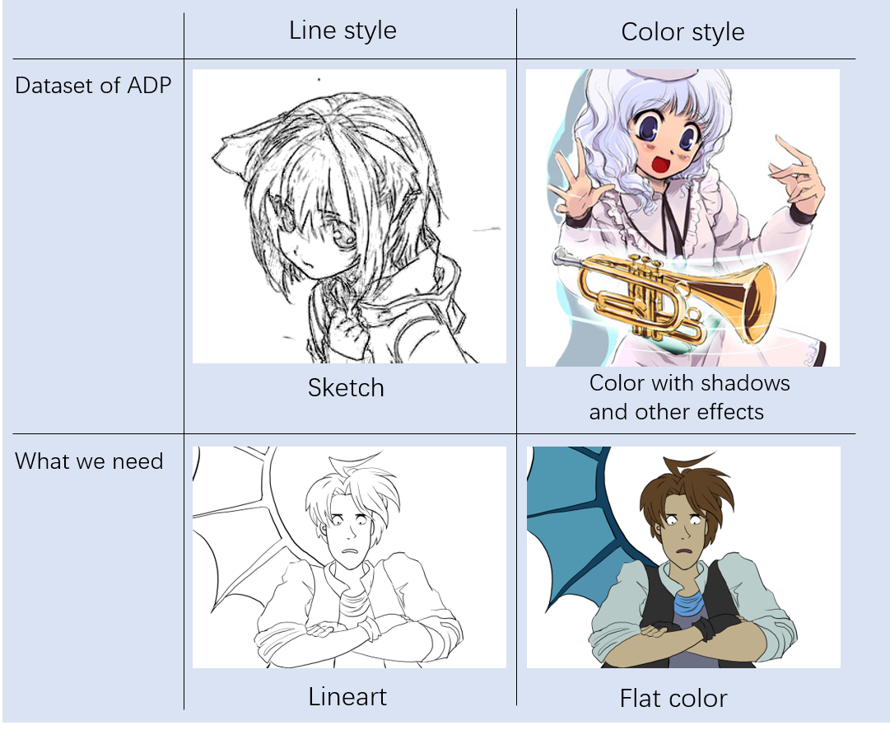
Review - Dataset

Slide 5
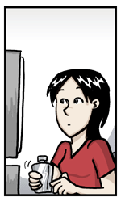
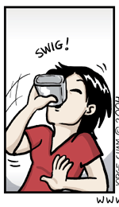
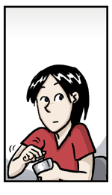
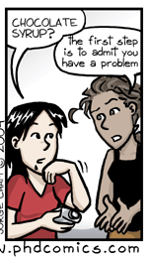
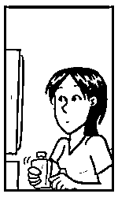
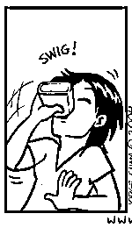
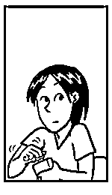
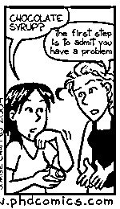
Review - Dataset

Slide 6
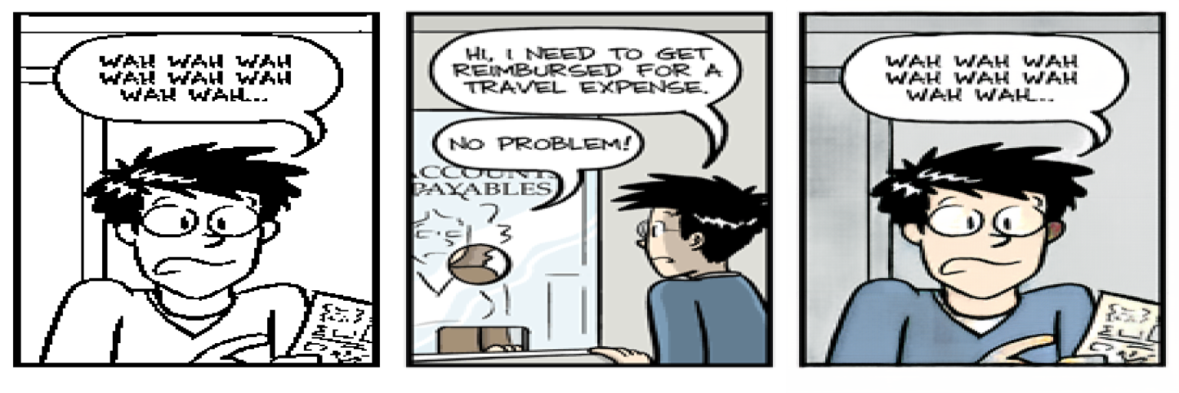
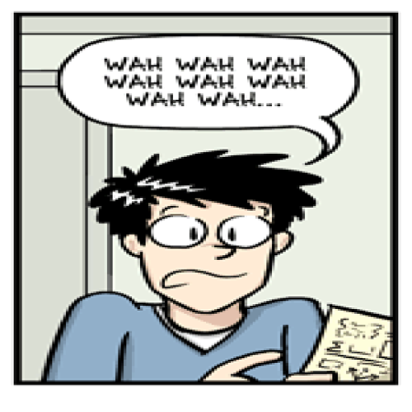
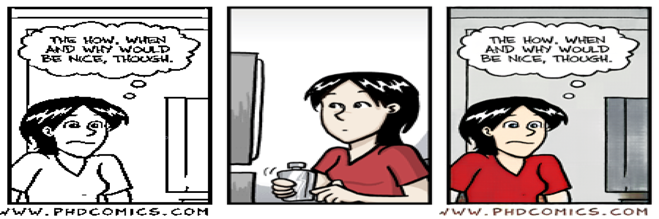

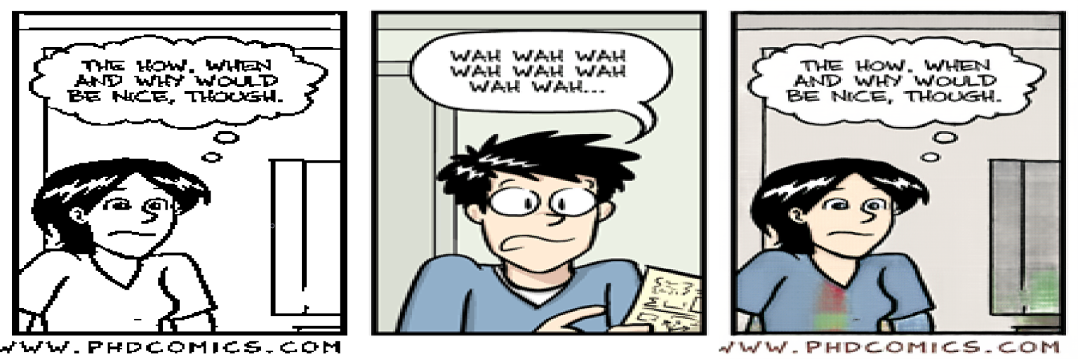
Review – Result
line-art reference image output ground truth
It works on the scenery which is similar to the training set
The model really transfers the color instead of ignoring the reference image!

Slide 7

Problem after training 50 epochs
line-art reference image output
The model really transfers the color instead of ignoring the reference image!
After 50 epochs:

Slide 8
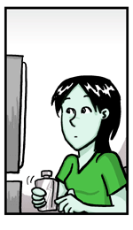
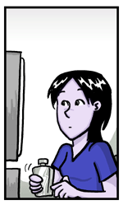
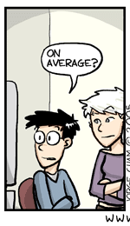
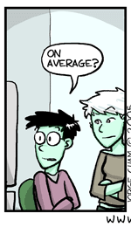
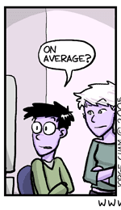
Idea: data augmentation
RGB
RGB
GBR
BRG

Slide 9
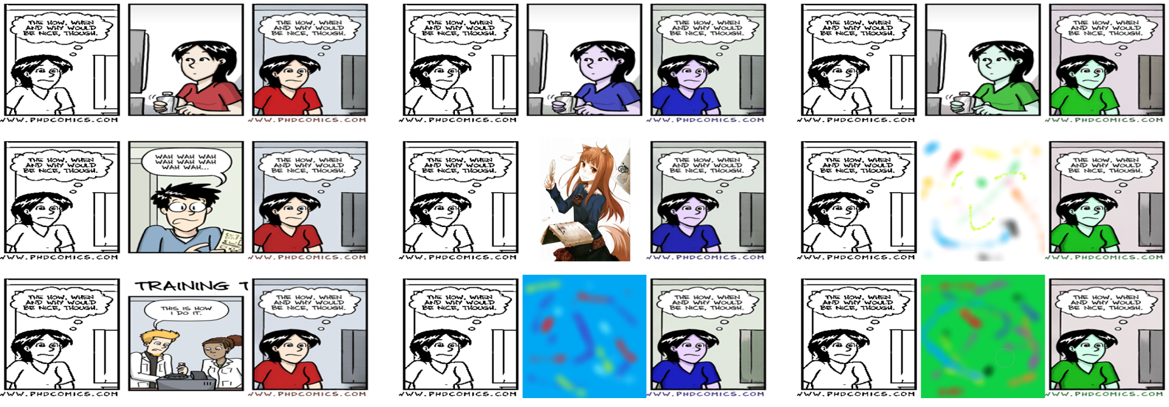
Result
Reference
Result
The reference images only decide which way the network will choose to colorize the lineart.
Classification

Slide 10
Idea
Force the network to use the colors from the reference image!
Mixing colors

Slide 11
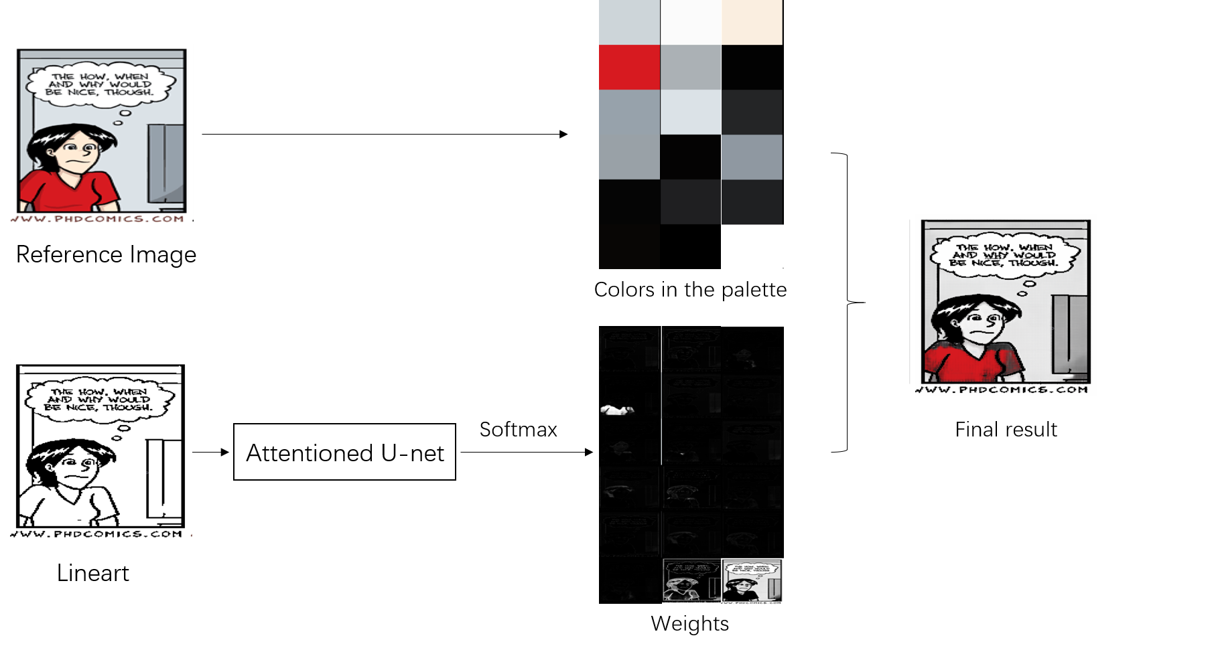
Color mixing model
Get the 16 colors from the reference.
Add black and white into palette for brightness.

Slide 12
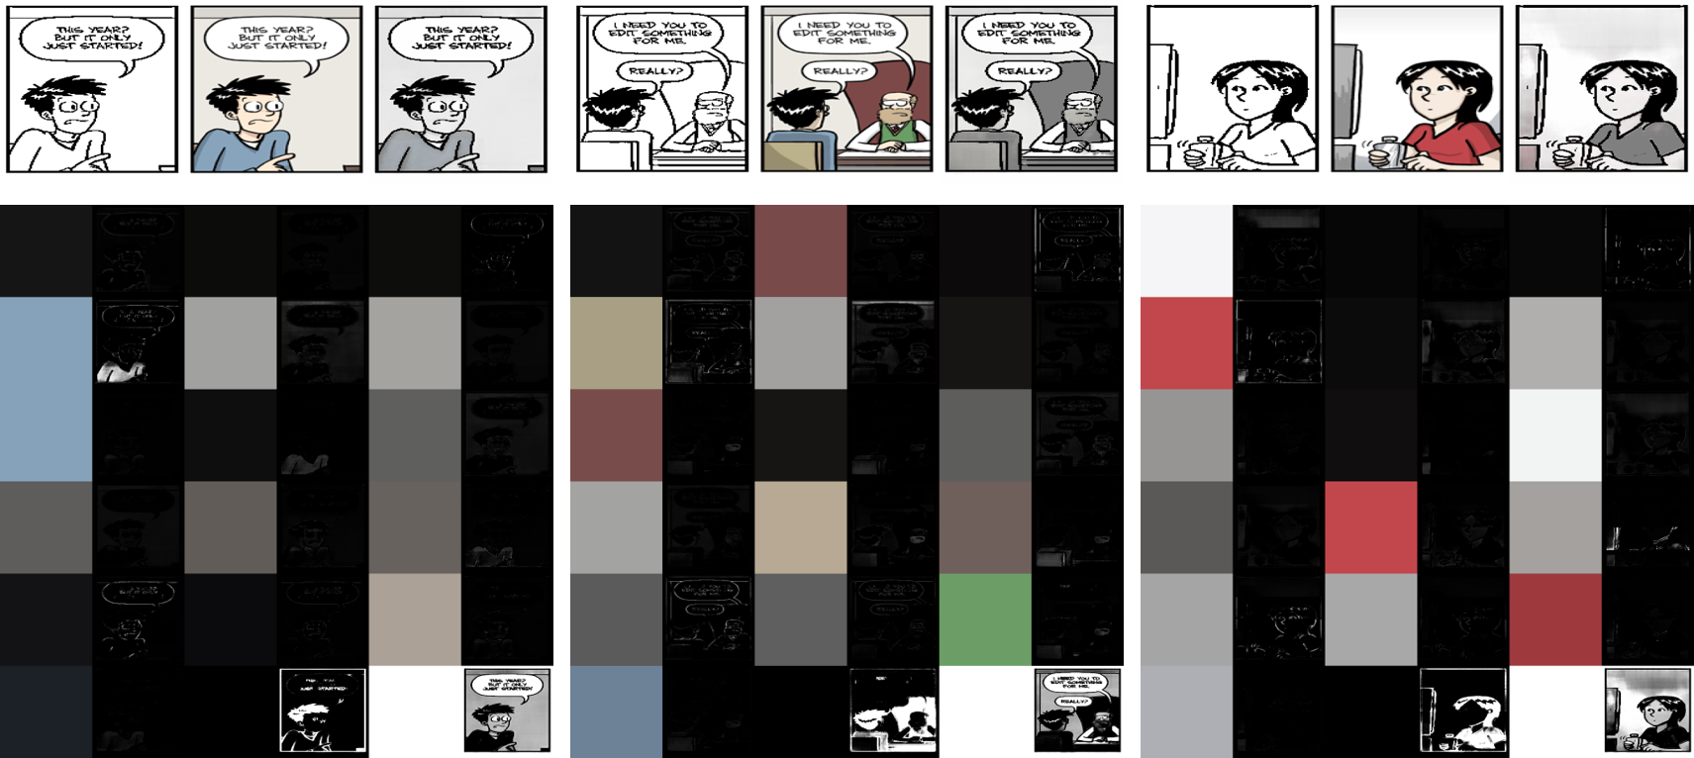
Result of Color mixing model
Most of the results are grey level images!
(Most of the weights are concentrated on black and white in the palette.)
(reliable colors)

Slide 13
Idea
Get more reliable colors!
Global Color Palette

Slide 14
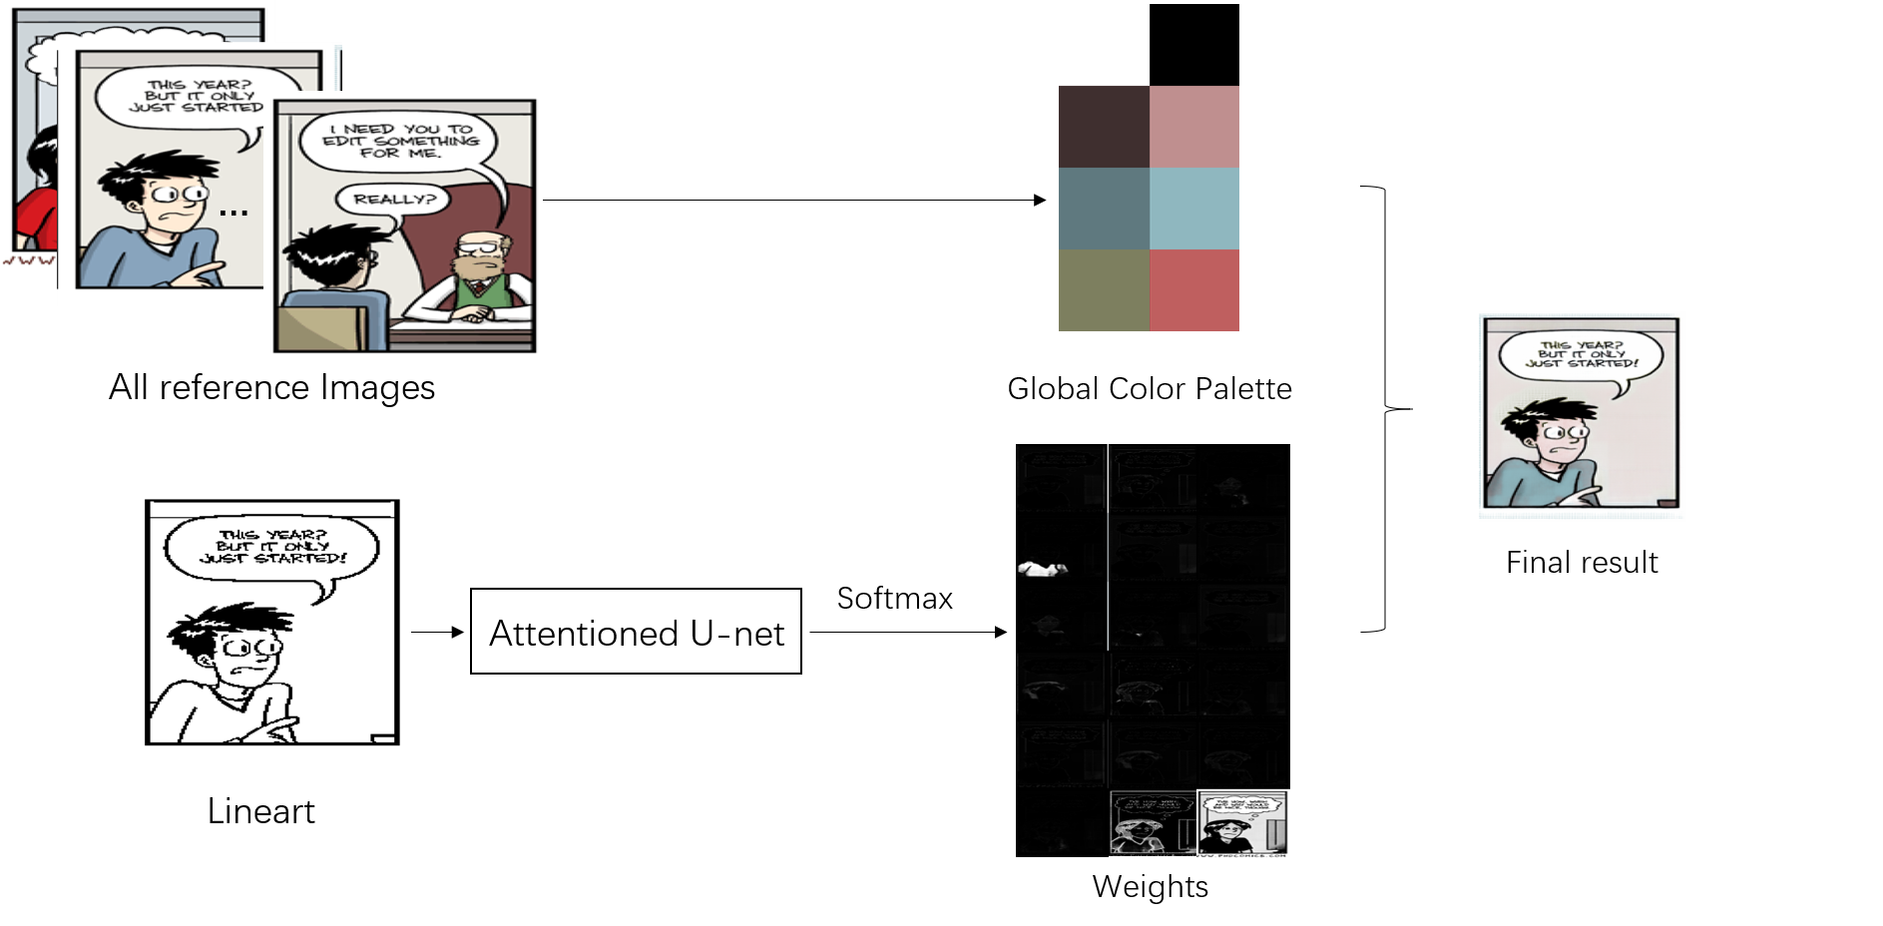
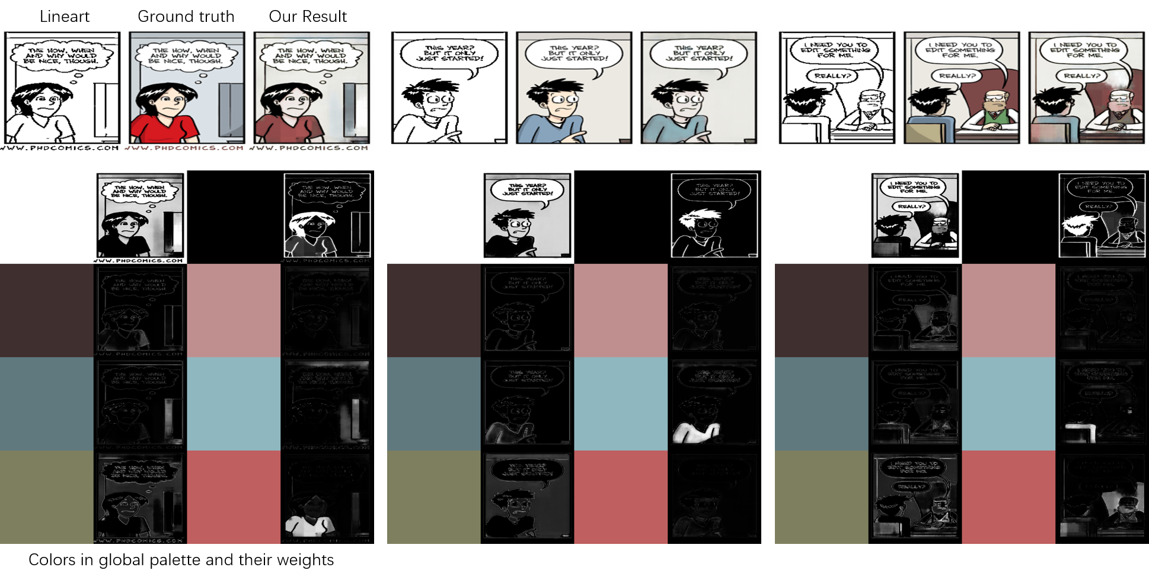
Global Color Palette Model

Slide 15
Result of Global Color Palette Model

Slide 16
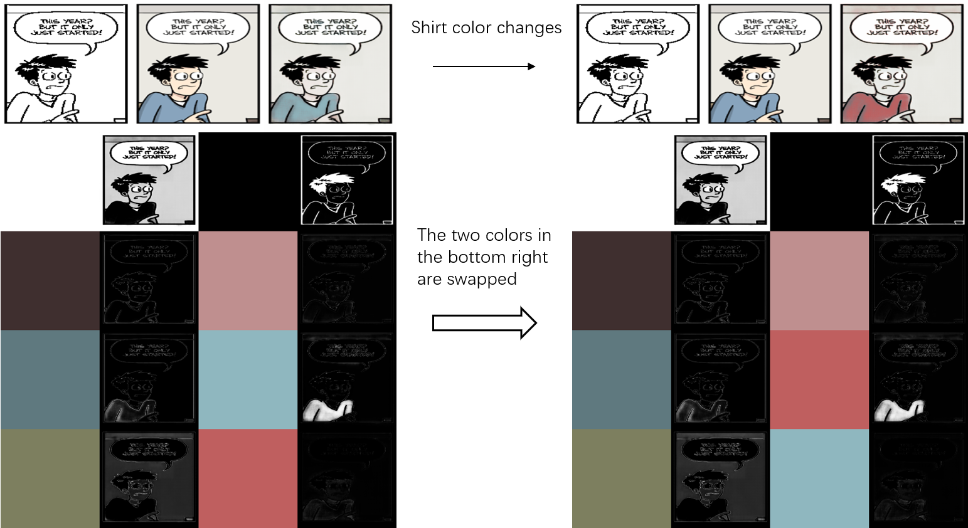
Color transfer

Slide 17
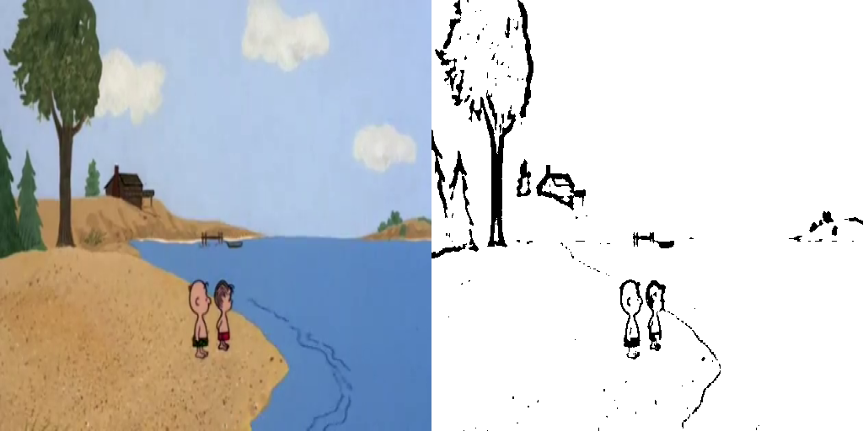
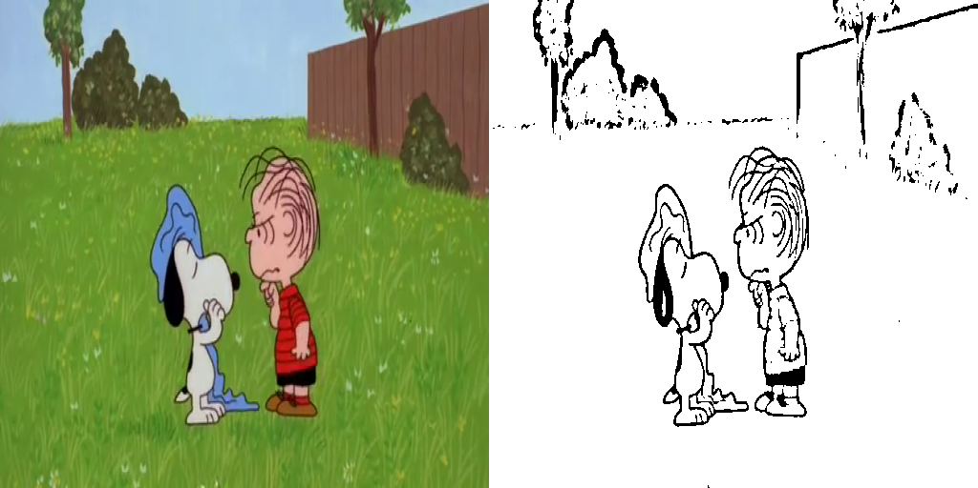
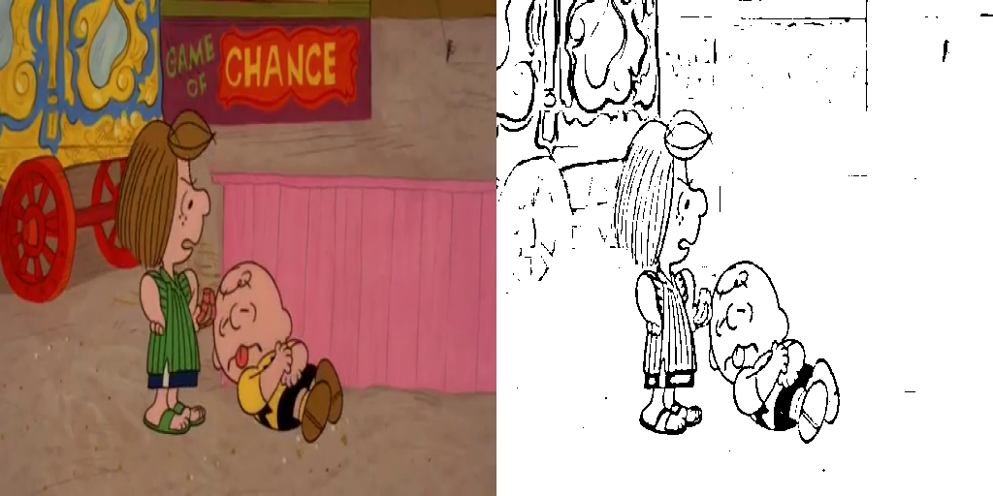
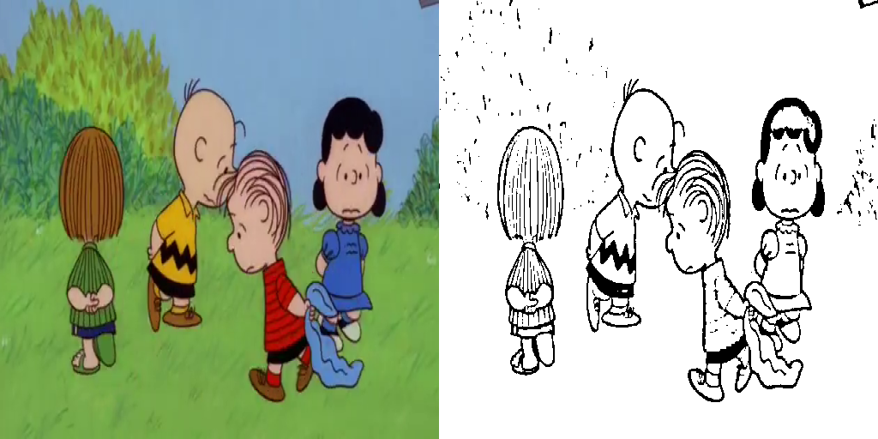
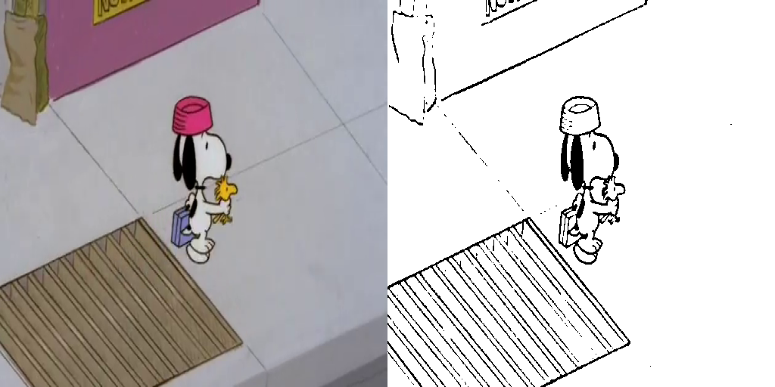
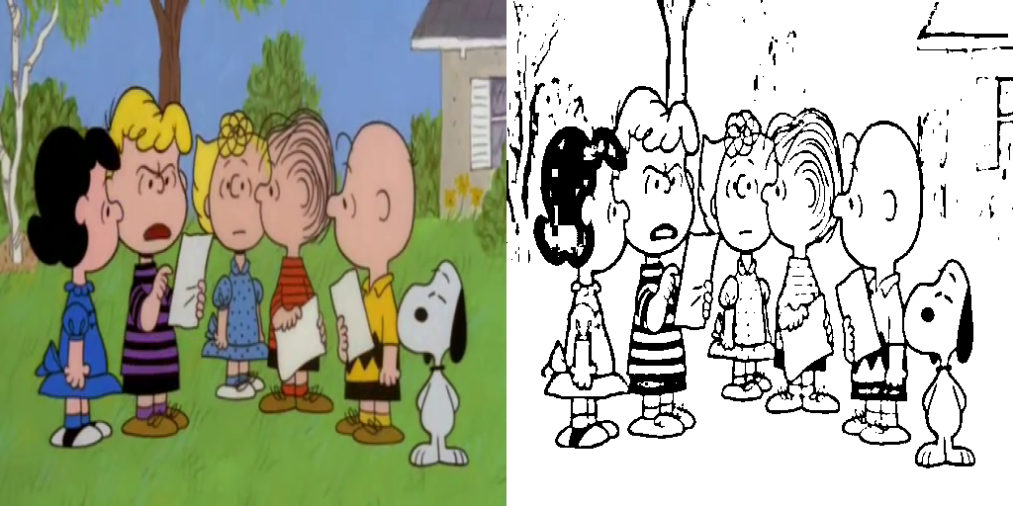
A more complicated dataset - Snoopy

Slide 18
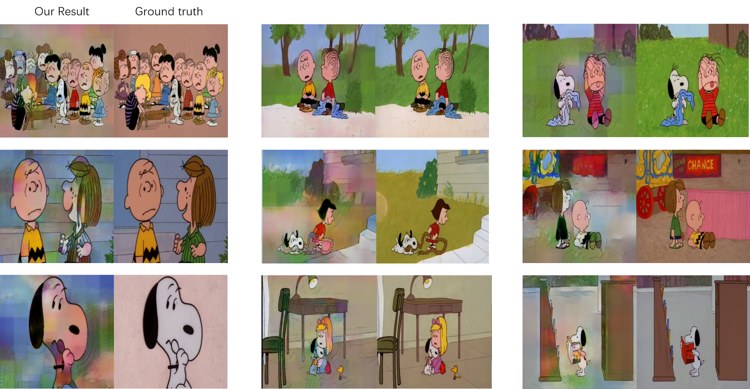
Result of Global Color Palette Model on Snoopy dataset

Slide 19
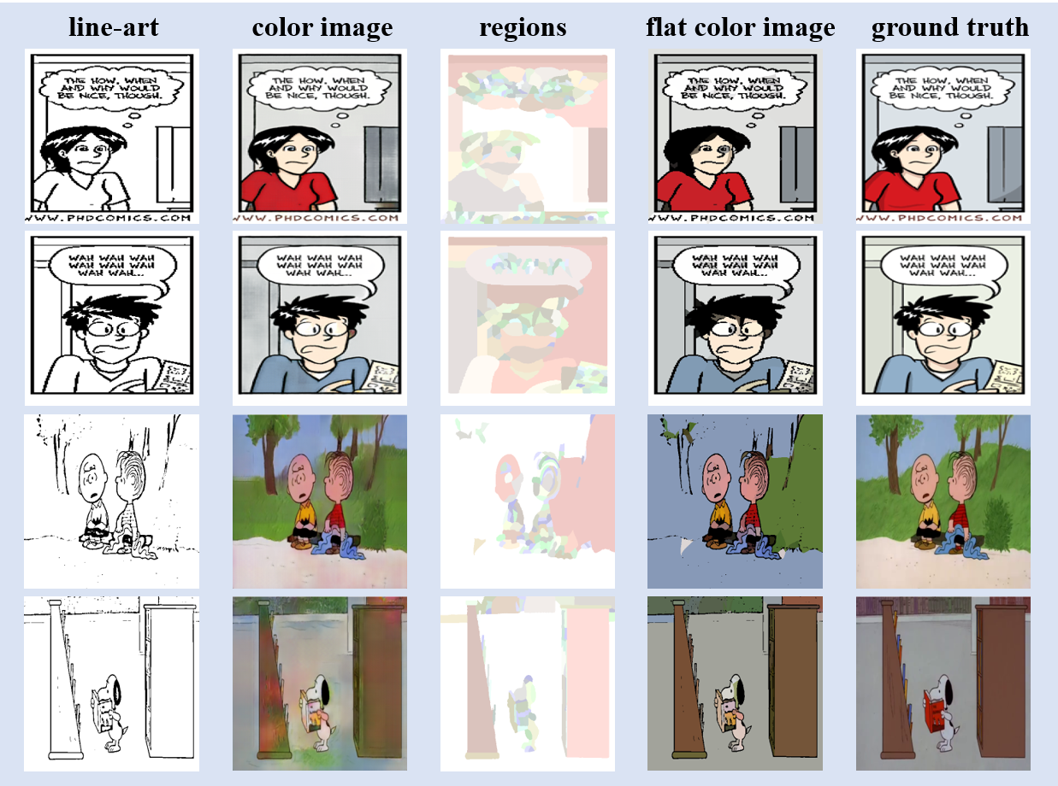
Final result

Slide 20
Final result

Slide 21
Final result

Slide 22
Summary
Train ADP on our dataset
Overfitting
Data augmentation
Classification
Color mixing model
Grey level output
Global color palette

Slide 23
Our contribution
1. Created three datasets (one is not shown) for training flat
coloring model.
2. Introduced a generator which uses mixing colors to generate
colored images.
3. Proposed a pipeline which can colorize linearts with flat colors.

Slide 24
Future plan
Using embedding model (instance segmentation) to perform this task.
Advantages:
Transfer the color by instances
2. Better region segmentation from linearts

Slide 25
Questions and suggestions :)
About model, datasets, flat coloring...
Train ADP on our dataset
Overfitting
Data augmentation
Classification
Color mixing model
Grey level output
Global color palette

Slide 26
Global Color Palette Model
Create bins: 16 for H, 4 for S, 4 for V.
Take all the pixels and count them in HSV bins.
Select the top 8 as the colors in palette.

Slide 27
Network – Image to Image
Generator
To make the generator knows how to fill the colors:
1. For each different comic series, different networks need to be trained.
2. Only works for a long serial comic since a big dataset is needed.

Slide 28
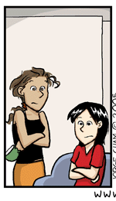
Network - Style transfer
Reference Image
Generator
The generator knows how to fill the colors from the reference image.
1. Only one network is needed.
2. Work for both long and short serial comics.

Slide 29
Grass
Green
T-shirt of character A
Grass
Dimension m in embedding space
Green
T-shirt of character A
Dimension n in embedding space
Green

Slide 30
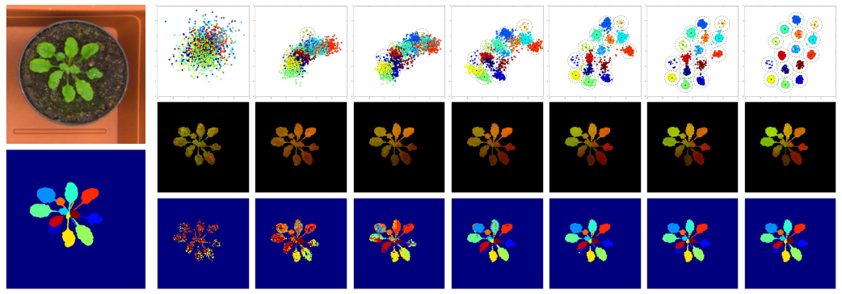
Paper: Semantic Instance Segmentation with a Discriminative Loss Function
Intro: An image can contain an arbitrary number of instances and that the labeling is permutation-invariant: it does not matter which specific label an instance gets, as long as it is different from all other instance labels.

Slide 31

